Slide 1

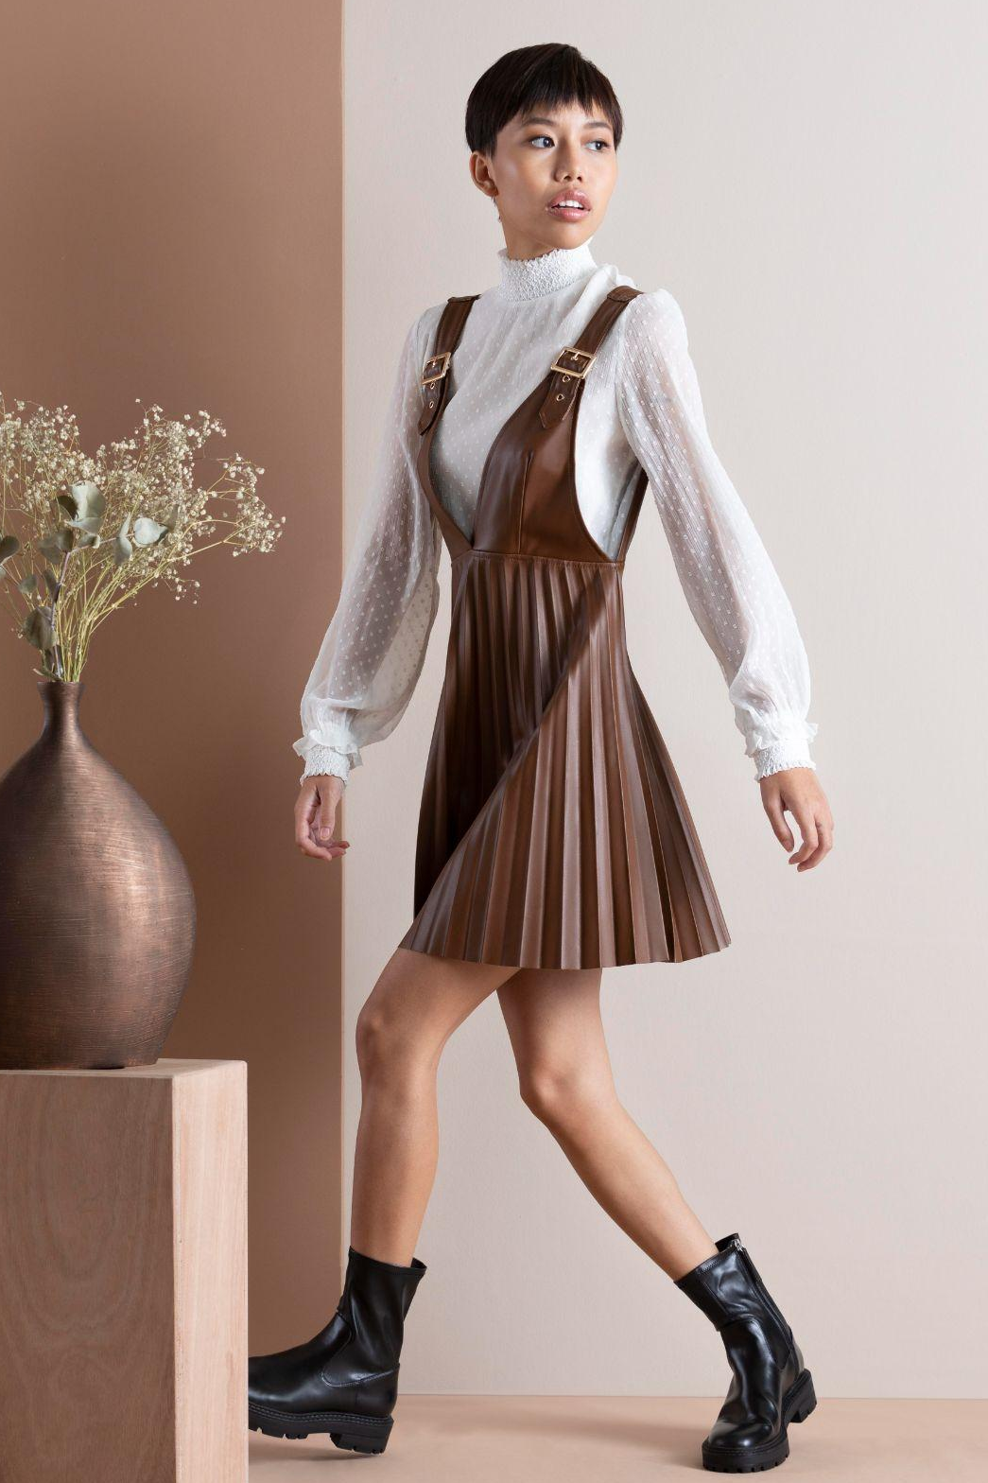

M2VIRA
THE FUTURE OF FASHION CLOTHES
@m2vira
@m2vira

Slide 2
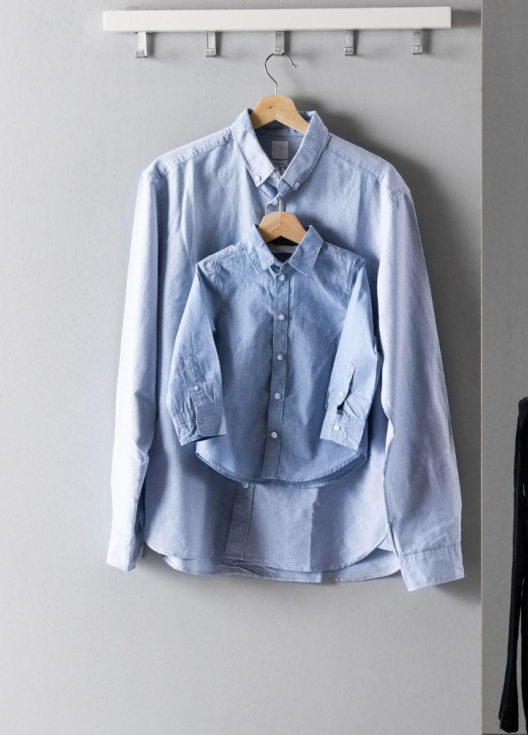

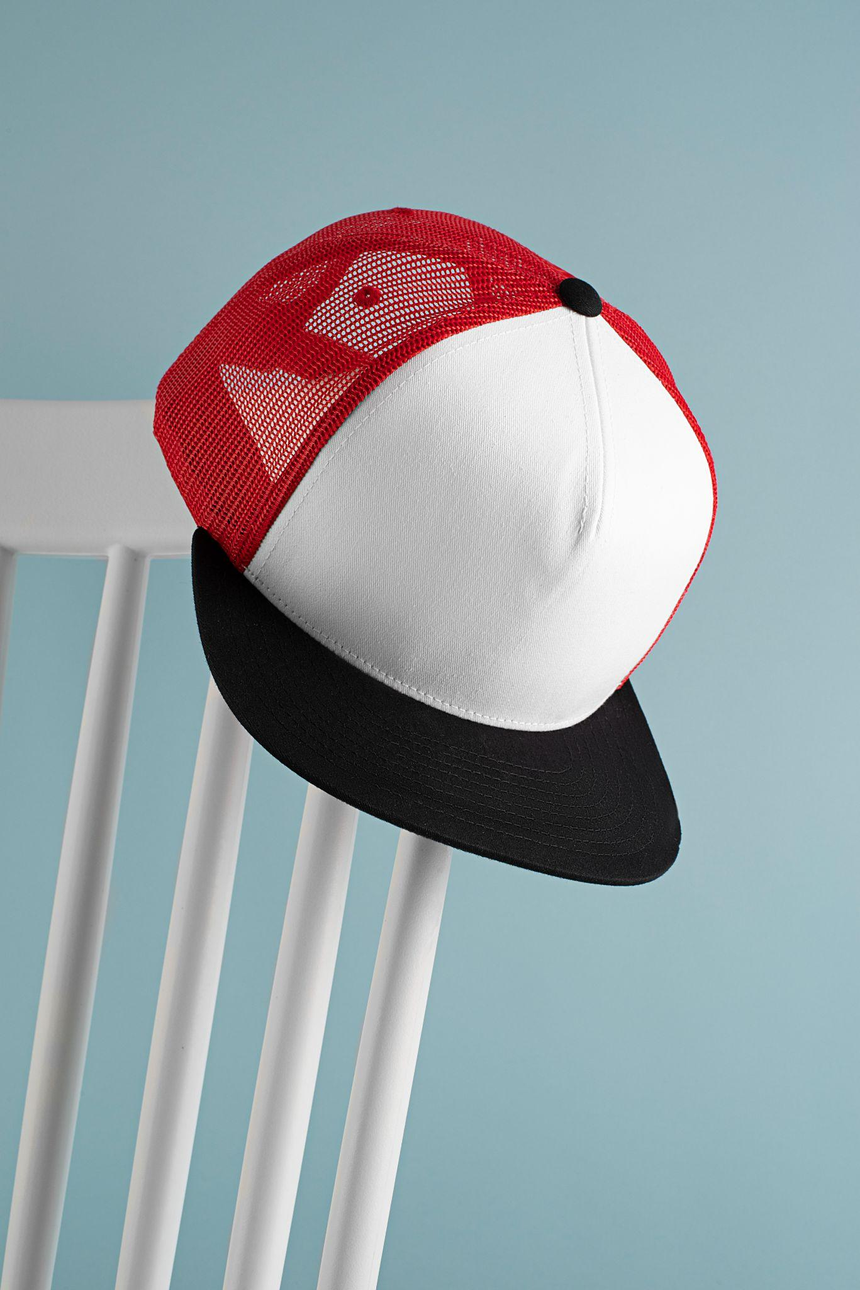
TABLE OF CONTENTS
01
02
03
04
TECHNOLOGIES
m2vira
DEMO
END

Slide 3


01
TECHNOLOGIES
@m2vira
What technologies were used to develop the project?
@m2vira

Slide 4




TECHNOLOGIES
TypeScript
mongoDB
Next.js
Firebase
We have used some modern technologies for the development of our website.
TypeScript is the programming language we used.
We used mongoDB for our database.
Next.js is a framework that allows us to easily develop and connect the front-end and the back-end.
We used Firebase for storing the images in the cloud.

Slide 5
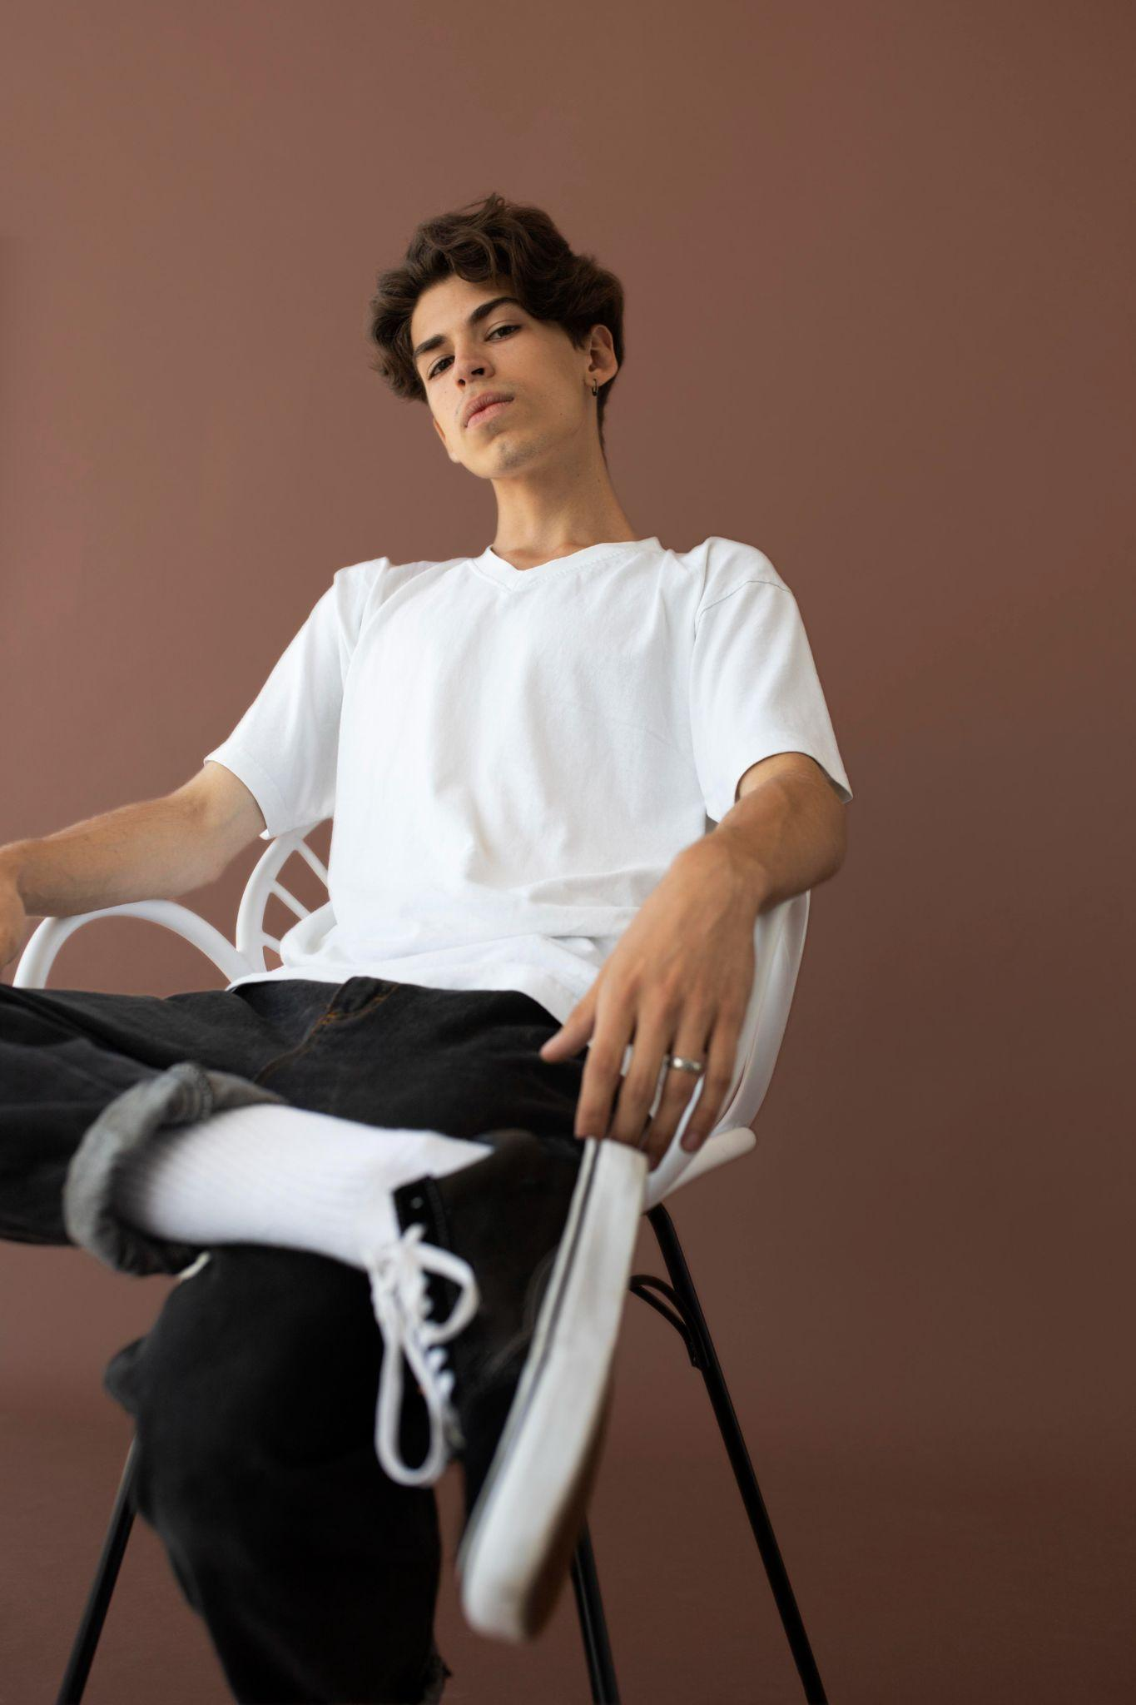
02
Vercel
@m2vira
@m2vira

Slide 6
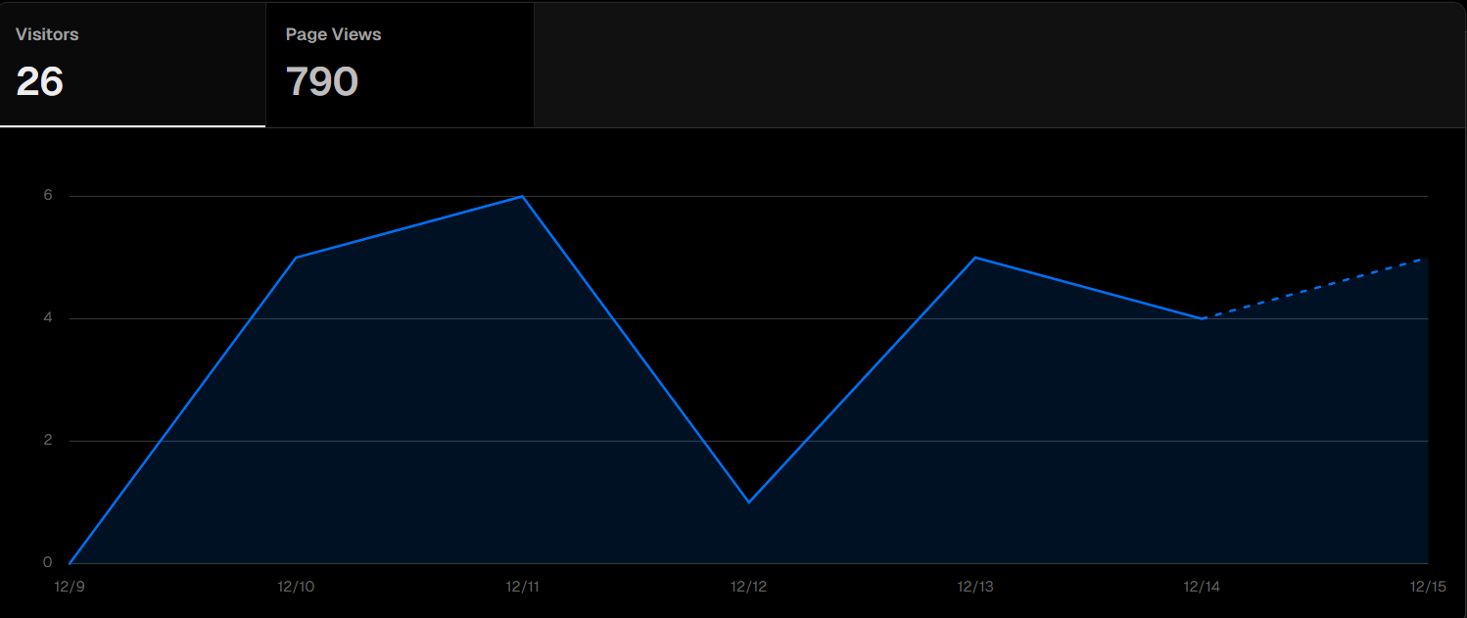
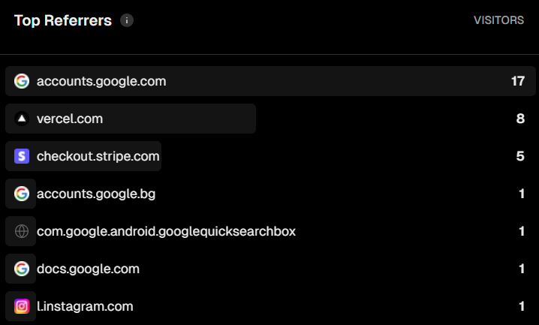
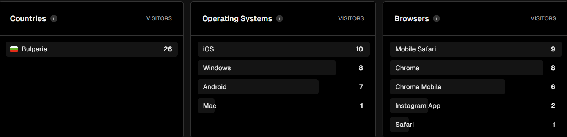
Vercel Analytics

Slide 7
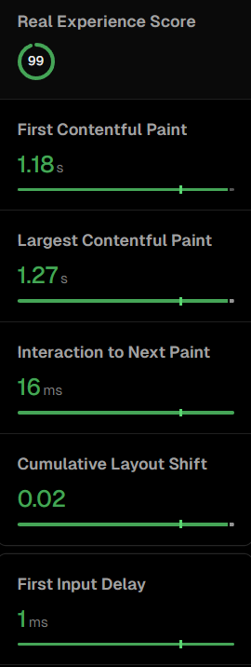
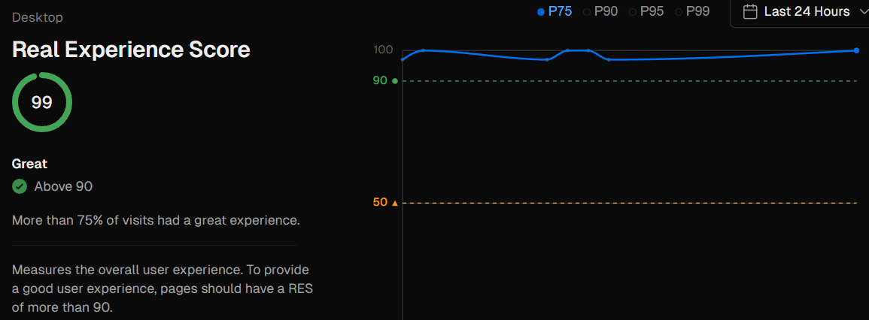
Vercel Speed Insights

Slide 8

LET’S HOP INTO THE DEMO → *click here*

Slide 9
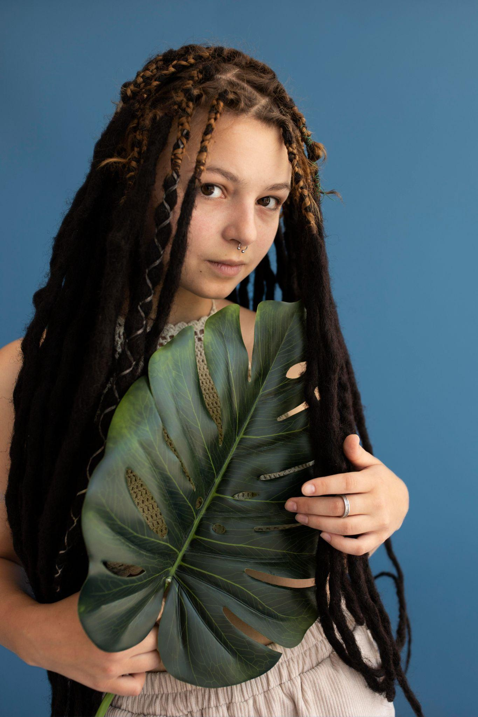
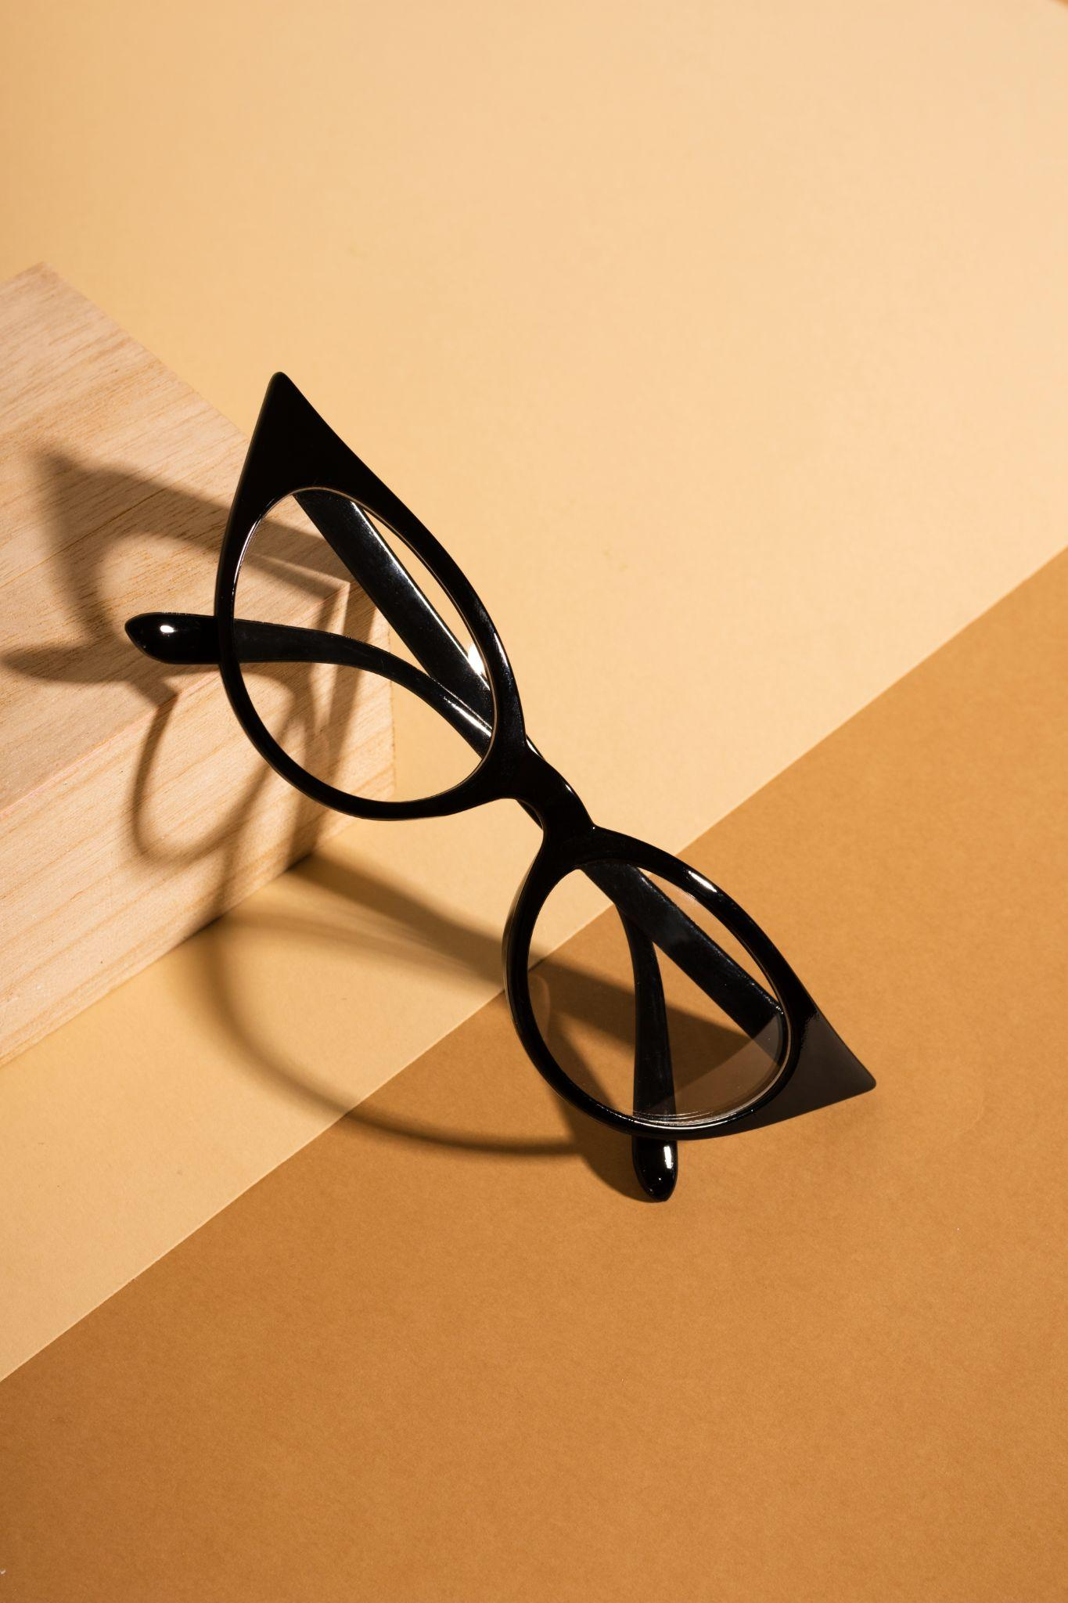
THANKS!
Any questions?
@modernclothing
@modernclothing

